Slide 1
UCAT 2020
22 June 2020 update
www.ucat.ac.uk

Slide 2
This presentation covers…
What is the University Clinical Aptitude Test (UCAT) and who uses it?
The UCAT process for 2020…
Important changes – where you can sit the test
Key Dates, Registration and Booking
Costs and Bursaries
What’s in the test?
How should I prepare for the test?
Taking the test, Marking and Results
More information

Slide 3
What is the UCAT?
Admissions test used in the selection process by a consortium of UK university medical and dental schools
Introduced in 2006 by a consortium of universities to help assess other ‘skills and attitudes’ needed by future doctors and dentists for successful clinical practice
No curriculum content; the test examines innate skills
Helps universities make more informed choices from amongst the many highly-qualified applicants who apply for their medical and dental degree programmes
Used in collaboration with other admissions processes: UCAS application, academic qualifications, references, MMI / interviews

Slide 4
What is the UCAT?
You sit the test in the same year that you apply through UCAS
You can only sit the test once each year
2 hour, multiple-choice, computer based test
Assesses a range of mental abilities across 5 separately timed subtests:
Verbal Reasoning
Decision Making
Quantitative Reasoning
Abstract Reasoning
Situational Judgement

Slide 5
UCAT Universities
University of Aberdeen
Anglia Ruskin University
Aston University
University of Birmingham
University of Bristol
Cardiff University
University of Dundee
University of East Anglia
Edge Hill University
University of Edinburgh
University of Exeter
University of Glasgow
Hull York Medical School
Keele University
Kent and Medway Medical School
King's College London
University of Leicester
University of Liverpool
University of Manchester
University of Newcastle
University of Nottingham
Plymouth University
Queen Mary, University of London
Queen's University Belfast
University of Sheffield
University of Southampton
University of St Andrews
St George's, University of London
University of Sunderland
University of Warwick

Slide 6
Key Dates & Fees 2020
Registration and testing have been delayed due to Covid-19
Key dates for this year are below:
1 July | Registration & Booking opens
3 August | Testing begins
17 September | Registration and online booking closes
30 September | Final booking deadline
1 October | Last testing date
15 October | UCAS application deadline
2020 Fees:
Test taken in the UK / EU | £75 | Test taken outside the EU | £120

Slide 7
Key Information for 2020
This year candidates will have the choice to sit the test at home using Pearson VUE’s online proctoring service (OnVUE) or at their nearest Pearson VUE Test Centre.
There is no difference between the test sat at home (the UCAT Online) and the UCAT sat in test centres.
Detailed Candidate Guides for each option will be published on our website. In those guides we advise you to think carefully about where you think you will perform your best.

Slide 8
Registration & Booking
From 1 July 2020 you can register and book your test via your Pearson VUE account.
We strongly advise everyone to book and sit your test as early as possible. This is more important than ever this year where the ongoing impact of COVID-19 is difficult to predict.
Only reschedule your test if there is an unavoidable reason.
After web booking closes (17 September) you must phone Customer Services to book a test.

Slide 9
Bursaries
Bursaries that cover the full test fee are available to EU candidates from low-income households
You may be eligible if you receive: 16-19 Bursary; Free School Meals; Learner Support; EMA; Full Maintenance Grant or Special Support Grant; Income Support; Job Seeker's Allowance; Universal Credit; Employment & Support Allowance; Asylum Support
You may also be eligible if your parent/guardian receives: Child Tax Credit; Income Support; Job Seeker's Allowance; Universal Credit; Employment & Support Allowance; Asylum Support
Check the Bursary Scheme page of our website for full details

Slide 10
Access Arrangements
If you are entitled to extra time and/or rest breaks for public examinations based upon a medical diagnosis or report from a specialist teacher we offer a number of versions of the test which should meet your needs (UCATSEN = 25% extra time, 50% extra time, rest breaks)
Applications for access arrangements (with supporting evidence) must be approved by the UCAT Office.
Likely to relate to dyslexia, dyspraxia, etc. but may apply to a range of other medical conditions
The Access Arrangements section of our website details the different accommodations we can support in our Test Centres and in the UCAT Online. Please check to see what is available.

Slide 11
What is in the Test?
Verbal reasoning | Assesses the ability to critically evaluate information that is presented in a written form
Decision making | Assesses the ability to apply logic to reach a decision or conclusion, evaluate arguments & analyse statistical information
Quantitative reasoning | Assesses the ability to critically evaluate information presented in a numerical form
Abstract reasoning | Assesses the use of convergent and divergent thinking to infer relationships from information
Situational judgement | Measures the capacity to understand real world situations and to identify critical factors & appropriate behaviour in dealing with them

Slide 12
Test Format (UCAT)
Subtest | Questions | Timing (includes 1 min per subtest for instruction)
Verbal Reasoning | 44 | 22 minutes
Decision Making | 29 | 32 minutes
Quantitative Reasoning | 36 | 25 minutes
Abstract Reasoning | 55 | 14 minutes
Situational Judgement | 69 | 27 minutes
Total time |  | 120 minutes
Notes:
This is based on the standard UCAT, obviously timings for the SEN are extended by 25%

Slide 13
Verbal Reasoning
The test assesses your ability to read and think carefully about information presented in passages and to determine whether specific conclusions can be drawn from information presented. You are not expected to use prior knowledge to answer the questions
21 minutes 44 questions 11 passages
Some questions assess critical reasoning skills, requiring candidates to make inferences and draw conclusions from information
For other questions you decide whether the statement provided follows logically from the information in the passage

Slide 14
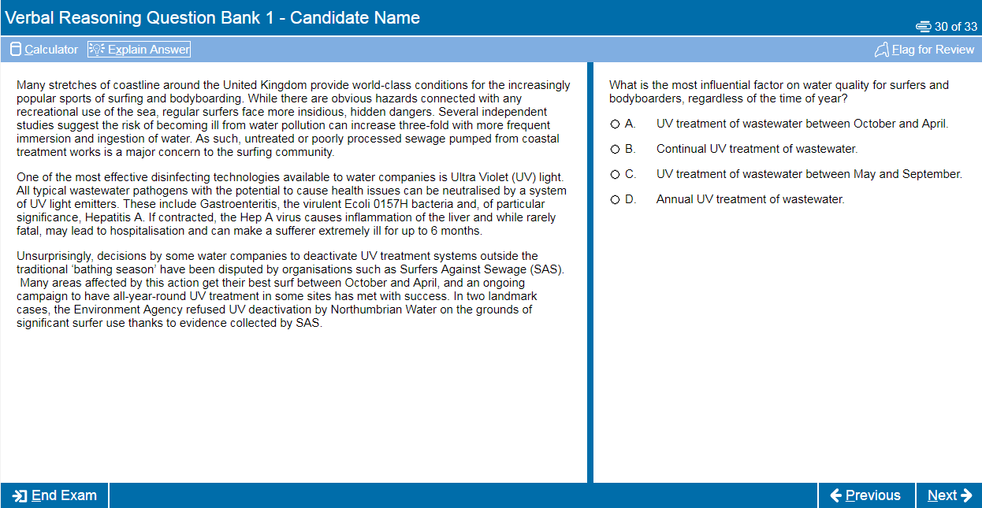
Verbal Reasoning

Slide 15
Decision Making
This subtest assesses the ability to apply logic to reach a decision or conclusion, evaluate arguments and analyse statistical information
31 minutes 29 questions
associated with diagrams, text, charts or graphs
There are a number of different question types including logical puzzles, syllogisms and Venn diagrams
All questions are standalone and do not share data
You can make notes using a whiteboard / marker pen or the in-built scratchpad

Slide 16
Decision Making

Slide 17
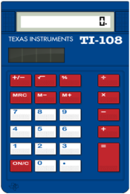
Quantitative Reasoning
The test assesses your ability to use numerical skills to solve problems
24 minutes 36 questions
associated with tables, charts, and/or graphs
It assumes familiarity with numbers, e.g. ratios, percentages, averages, fractions, etc.
A basic calculator is available for use in this section
You can make notes using a whiteboard / marker pen or the in-built scratchpad

Slide 18
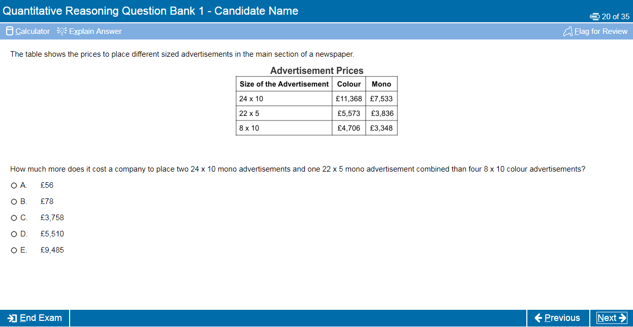
Quantitative Reasoning

Slide 19
Abstract Reasoning
The test assesses your ability to identify patterns amongst abstract shapes where irrelevant and distracting material may lead to incorrect conclusions
The test therefore measures your ability to change track, critically evaluate and generate hypotheses and requires you to query judgements as you go along
There are 4 different questions types in this test
13 minutes 55 questions
associated with numerous sets of shapes

Slide 20
Abstract Reasoning

Slide 21
Situational Judgement
The test measures your capacity to understand real world situations and to identify critical factors and appropriate behaviour in dealing with them
It assesses the key traits of integrity, perspective taking and team involvement, resilience and adaptability
SJTs are used widely in medical selection, including selection of Foundation Doctors, GPs and other medical specialties
26 minutes 69 questions 21 scenarios (consisting of between 2 and 6 responses)

Slide 22
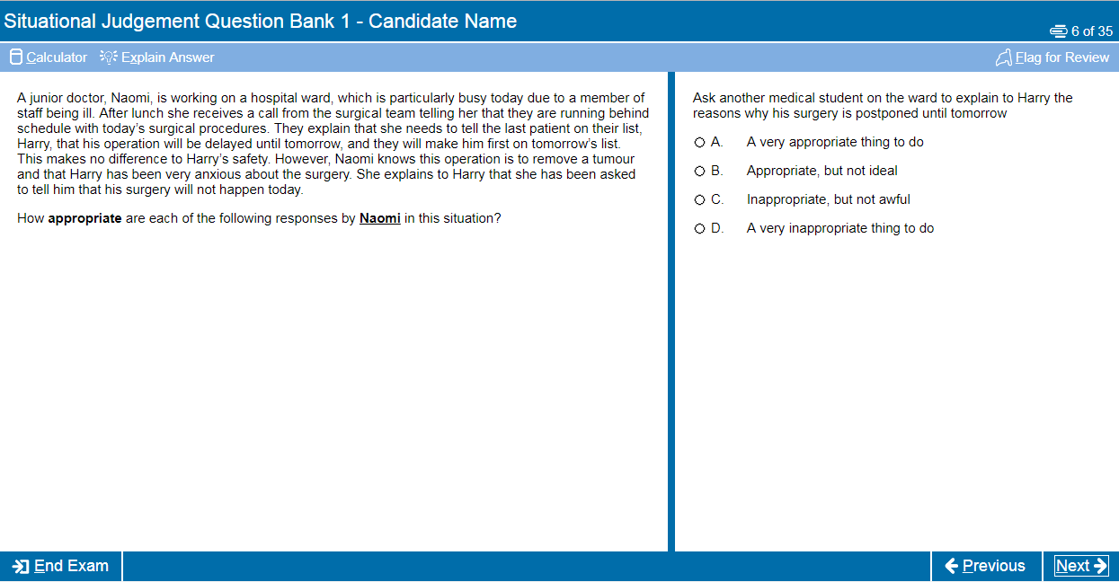
Situational Judgement

Slide 23
How should I prepare?
Although it is a test of aptitude rather than academic knowledge, you should still allow time to prepare thoroughly for the UCAT
We recommend you spend around 25-30 hours preparing for the test
Start at least 4-6 weeks before your test date
Use the FREE resources available on the UCAT website (we have over 1,000 example questions)
Use the official practice tests to familiarise yourself with the online calculator and scratchpad functionality

Slide 24
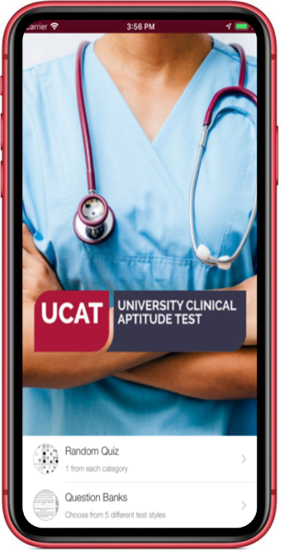
Practice Tests and Resources
Tour Tutorial
Question Tutorial
Question Banks
UCAT Official App
Practice Tests
Thousands of FREE
Practice Questions

Slide 25
Commercial Preparation Materials
Whilst there are many commercial companies offering coaching for the test, we do not work with any of these companies or endorse the use of their materials
Taking advantage of these opportunities can cost a great deal of money
We would advise you to be sceptical about claims they can help you do well in the test by coaching
Their materials and scoring may not necessarily of the standard you will encounter in the UCAT
This may distort your performance whilst practising and give you misleading indicators of your anticipated score

Slide 26
Tips & Advice
If you have not studied maths beyond GCSE level (or recently), revisit and practice these skills (QR and DM subtests)
Brush up on your mental maths (QR)
Practice your speed reading skills (VR)
Don’t be fazed by Abstract Reasoning, although this may be new you’ll soon start to recognise patterns (colour, shape, size, rotation, symmetry)
Read the GMC Guidelines on Good Medical Practice if you are struggling with SJT

Slide 27
Tips & Advice
Practise the test timings, try to answer all the questions, don’t leave blanks
Remember that no points are deducted for wrong answers so if you’re stuck use your best guess
Use the Flag and Review functions of the test effectively to manage your time
Use the official practice tests towards the end of your preparation to see where you need to improve your speed / manage your time more effectively

Slide 28
Taking the Test at a Test Centre
Arrive at the Test Centre at least 15 minutes before you are due to start. If you are late you may not be allowed to test and will have to pay again
Very important - make sure you take the correct ID or you will not be allowed to sit the test!
Other people will be testing in the same room as you so you can ask for ear plugs or headphones to limit disturbance – this is not like a school exam
Due to COVID-19 additional measures will be in place - specific information is available on the Pearson VUE website but a Facemask is strongly recommended at UK test centres
If you experience any issues during your test you must notify the invigilator immediately

Slide 29
Taking the UCAT Online at home
Run a system test before your test day to ensure you can meet the technical requirements
If you want to use a whiteboard / erasable marker to make notes during the test, you will need to obtain / borrow these
Allow 30 minutes before your appointment to complete the check-in process
Ensure you have the right photo ID and if you are under 18 that a parent/guardian is present during the check-in process with their photo ID
Make sure no one else enters the room during your test
If you experience any issues during your test, notify the Proctor

Slide 30
Marking
Your UCAT result will comprise of:
A score of between 1200 to 3600
A banding for Situational Judgement
Verbal Reasoning – 300 to 900
Decision Making – 300 to 900
Quantitative Reasoning – 300 to 900
Abstract Reasoning – 300 to 900
Situational Judgement – Band 1 to 4 (1 = highest)
Total mean average score in 2019 = 2483

Slide 31
Results
Results are available on the day of your test (at a test centre), or within 24 hours via your PV account
Before you submit your UCAS application check how universities use the test or you might be wasting an application
We liaise with UCAS to confirm your university choices and pass your results to your university choices directly in early November
You do not need to tell us your application choices or UCAS PID or pass your test result to your universities yourself

Slide 32
More Information
Visit the UCAT website: ucat.ac.uk
Follow UCAT on social media to see extra FREE practice questions and important updates on any changes to 2020 testing due to COVID-19
@ucatofficial
OfficialUCAT

